Slide 1
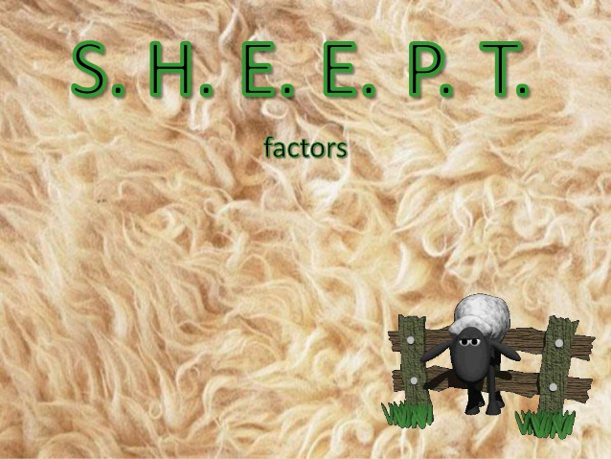

Slide 2
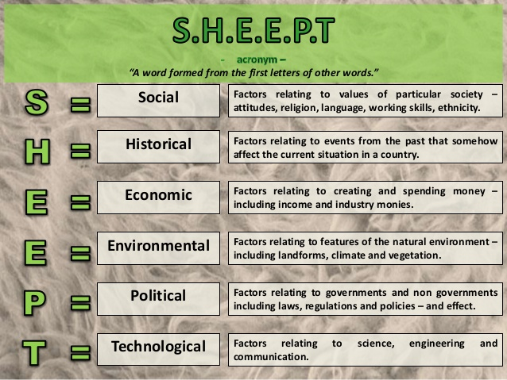

Slide 3


Slide 4


Slide 5


Slide 6


Slide 7


Slide 8


Slide 9
Lets do our own factor analysis
Choose a location
S
H
E
E
P
T

